Slide 1

Mapping the impact of covid-19 on Employment
Archit Jain| IGME_770

Slide 2
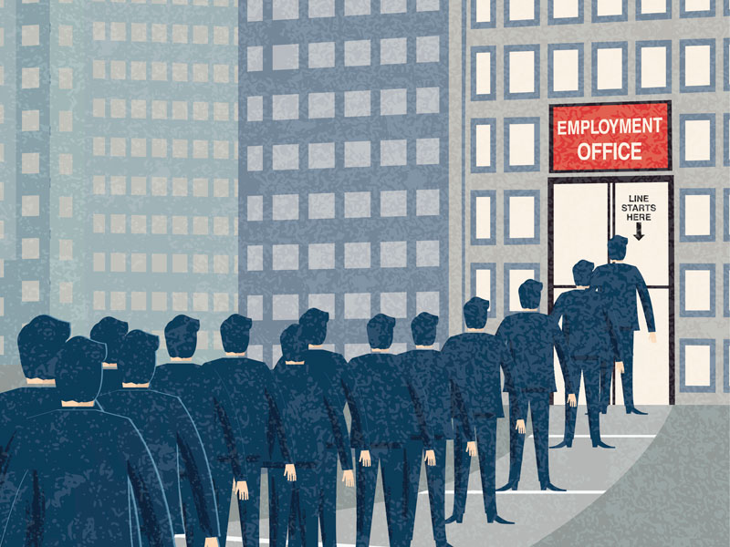
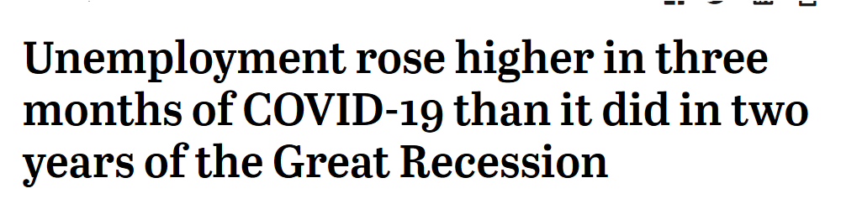
Problem
Due to Covid-19 the unemployment rate is high. There was surge in unemployment in United States during the first quarter of 2020.
Notes:
Insert a map of your country.

Slide 3

“The COVID-19 outbreak and the economic downturn it engendered swelled the ranks of unemployed Americans by more than 14 million, from 6.2 million in February to 20.5 million in May 2020.
As a result, the U.S. unemployment rate shot up from 3.8% in February – among the lowest on record in the post-World War II era – to 13% in May.”
- https://www.pewresearch.org

Slide 4

Motivation
Can identify the areas where the economy is most hit, and the virus is not prevalent anymore.
Policy makers can develop a more focused for policies for the impacted group.
Analyst can plan strategic economic rebound.
Notes:
Insert a picture of one of the geographic features of your country.

Slide 5
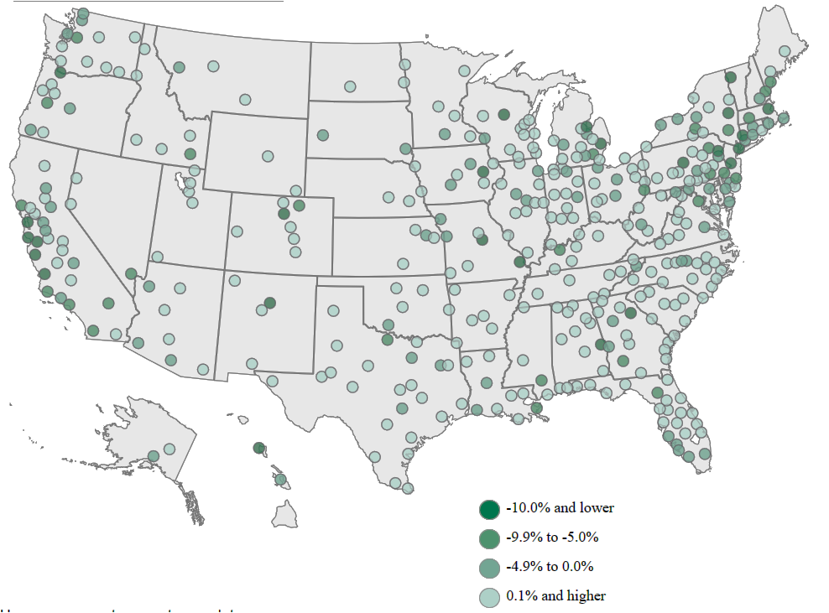
Goals and objectives
Map the areas with unemployment rate in US
Gather the Data from CDC, US department of Labor
Compare the data from 2019 to 2020 to draw any drastic changes.
Notes:
Insert a picture illustrating a season in your country.

Slide 6
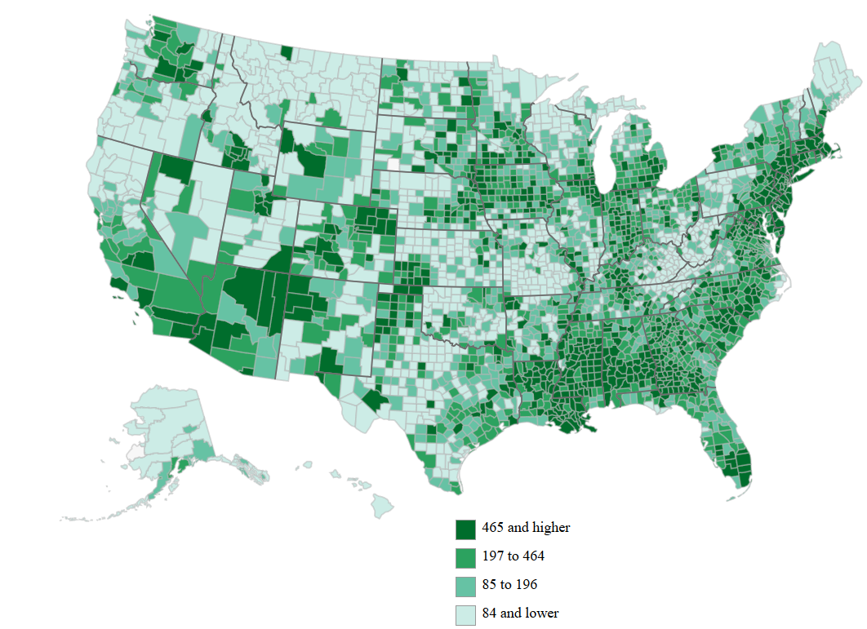
Literation review
Michael Dalton, "Geographic impact of COVID-19 in BLS surveys by industry," Monthly Labor Review, U.S. Bureau of Labor Statistics, August 2020, https://doi.org/10.21916/mlr.2020.17.
Number of Coronavirus cases by County
“The Impact of COVID-19 on Small Business Outcomes and Expectations | PNAS,” accessed September 25, 2020, https://www.pnas.org/content/117/30/17656.
George Borjas and Hugh Cassidy, “The Adverse Effect of the COVID-19 Labor Market Shock on Immigrant Employment” (Cambridge, MA: National Bureau of Economic Research, May 2020), https://doi.org/10.3386/w27243.
Notes:
Insert a picture of an animal and or plant found in your country.

Slide 7
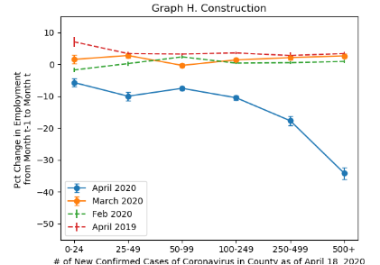
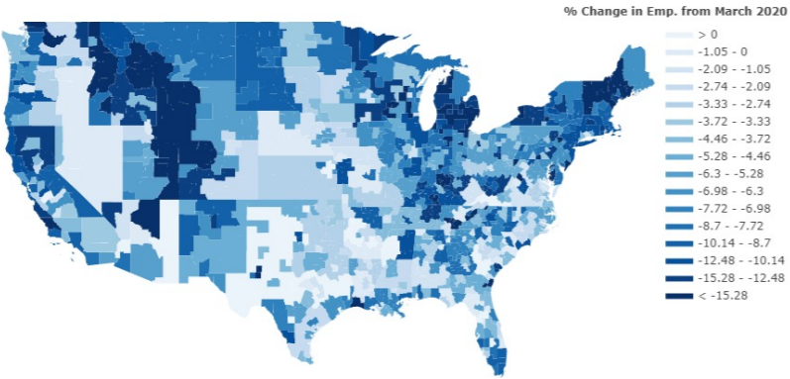
Geographic impact of COVID-19 in BLS surveys by industry
The Paper by U.S. Bureau of Labor Statistics.
Compares the impact of Covid-19 on unemployment by Industry
Based on Population and Employment Surveys
Impact hospitality , construction, transportation highest
White collored jobs most unaffected

Slide 8
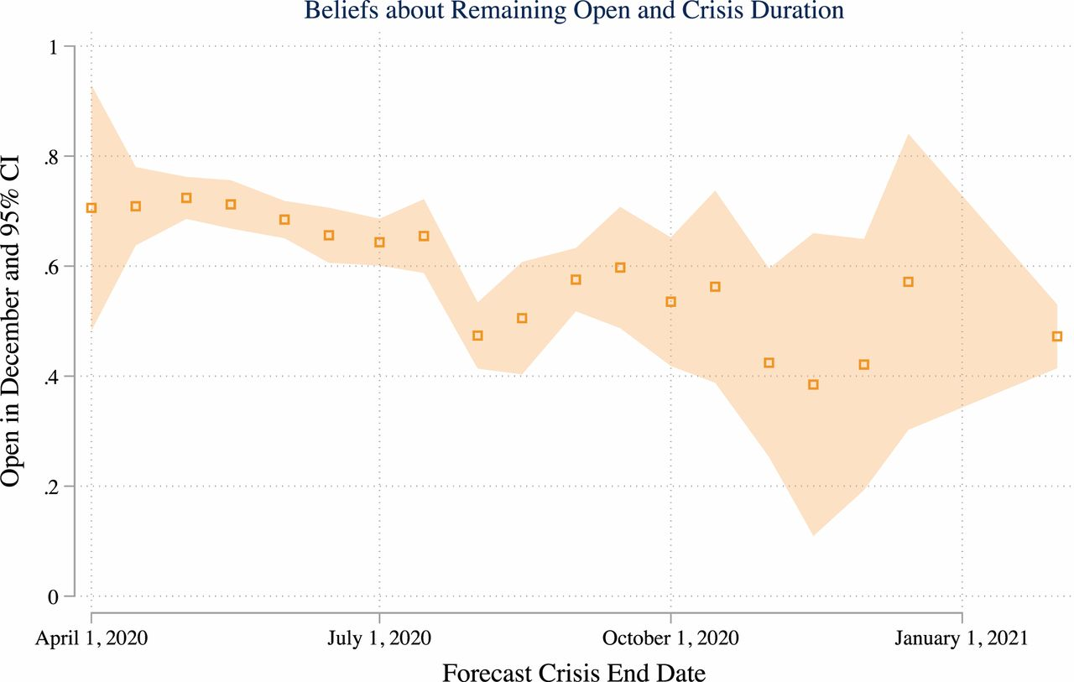
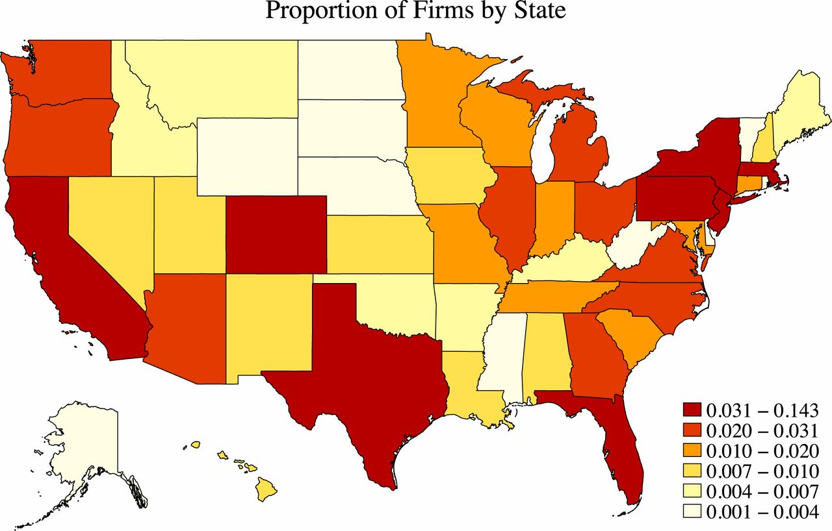
The impact of COVID-19 on small business outcomes and expectations
Drawing on a survey of more than 5,800 small businesses
Explores the impact coronavirus on small business.
Takes the length of the crisis in consideration to predict the increase/decline in business.

Slide 9
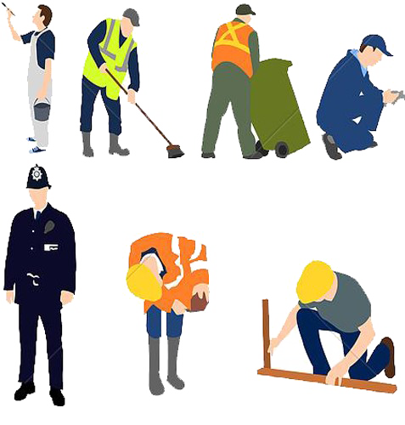
THE ADVERSE EFFECT OF THE COVID-19 LABOR MARKET SHOCK ON IMMIGRANT EMPLOYMENT
Interesting study shows the impact on immigrant population.
Use CPS files to document the decline in unemployment is severe for immigrants.
Disparate employment consequences due to availability of remote jobs.

Slide 10
References
https://www.pewresearch.org/fact-tank/2020/06/11/unemployment-rose-higher-in-three-months-of-covid-19-than-it-did-in-two-years-of-the-great-recession/
Michael Dalton, "Geographic impact of COVID-19 in BLS surveys by industry," Monthly Labor Review, U.S. Bureau of Labor Statistics, August 2020, https://doi.org/10.21916/mlr.2020.17.
“The Impact of COVID-19 on Small Business Outcomes and Expectations | PNAS,” accessed September 25, 2020, https://www.pnas.org/content/
George Borjas and Hugh Cassidy, “The Adverse Effect of the COVID-19 Labor Market Shock on Immigrant Employment” (Cambridge, MA: National Bureau of Economic Research, May 2020), https://doi.org/10.3386/w27243117/30/17656.
https://www.bls.gov/covid19/effects-of-covid-19-pandemic-on-employment-and-unemployment-statistics.htm
https://www.ncsl.org/research/labor-and-employment/covid-19-impact-on-employment-and-labor.aspx
https://www.cdc.gov/
Notes:
Add key points in the history of your country to the timeline.

Slide 11

Notes:
Insert a picture illustrating a custom or tradition here.

